Slide 1
Foreign and autoreactive cd4 conventional and regulatory t cells in T1D and healthy subjects
Thomas H. Edwards
Bioinformatician I
Benaroya Research Institute
Center for Systems Immunology
20240905

Slide 2

Acknowledgements
Bioinformatics Core
Hannah DeBerg
Stephan Pribitzer
Matt Dufort
Alex Hu
Matt Lawrence
Ty Bottorff
Andrew Koval
Kenneth Lai (2023 intern)
Genomics Core
Vivian Gersuk
Kimberly O’ Brien
CATA Core
Adam Wojno
Cerosaletti Lab
Karen Cerosaletti
Janice Chen
Software & Data Management
Charlie Quinn
Alex Walker
Adarsh Manjunath
Anna Bjork
Robyn Meshulam
Seattle Children’s Research Center
David J. Rawlings

Slide 3
Overview
Background & Motivation
T cells in Type 1 Diabetes
Prior work
Current Study
Data & Results

Slide 4
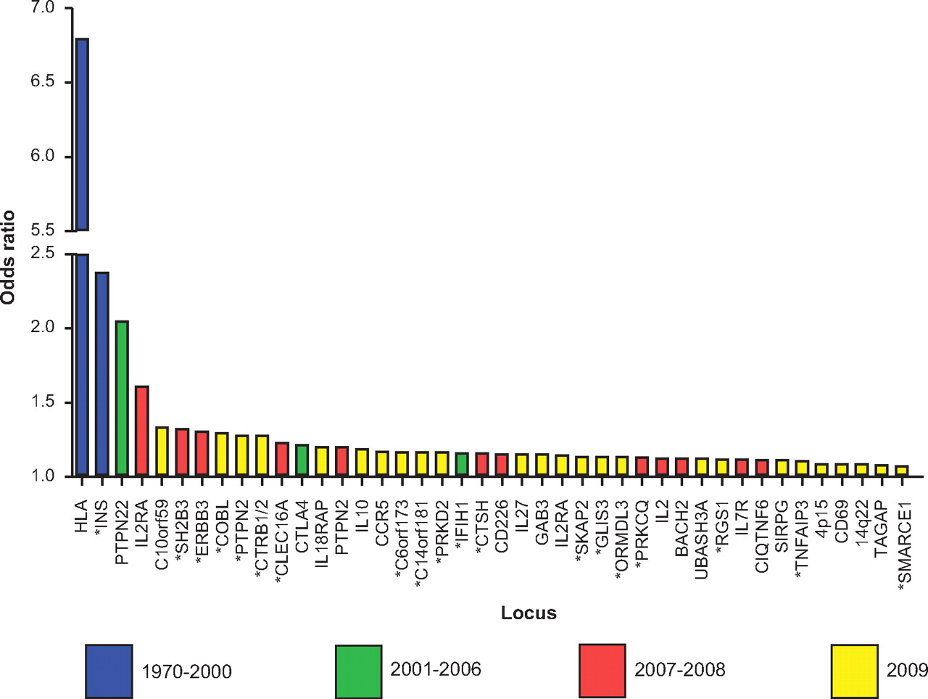
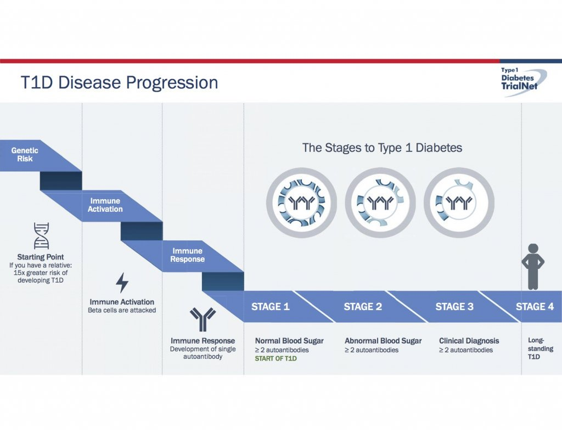
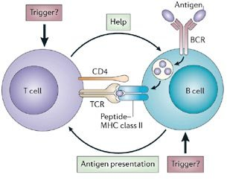

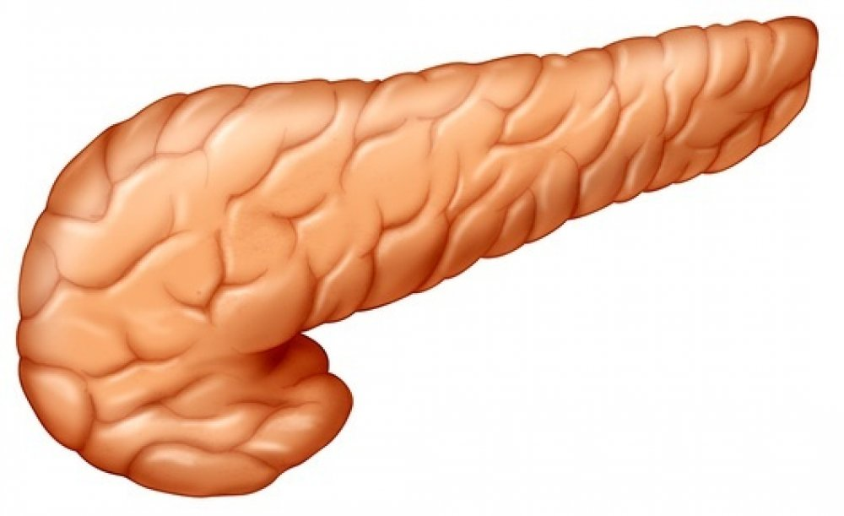
Islet antigen reactive t cells play a crucial role in t1d

Slide 5

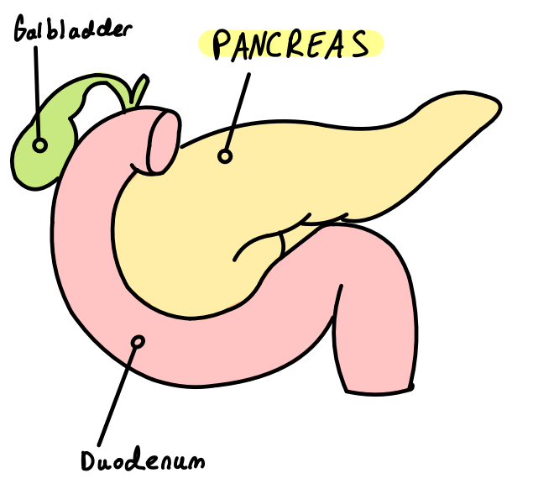
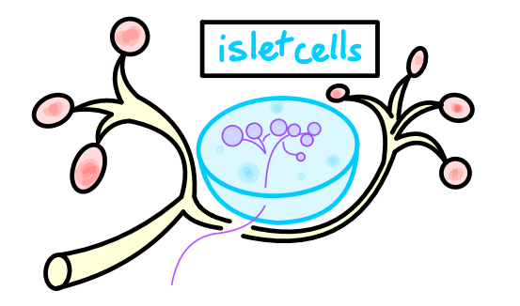
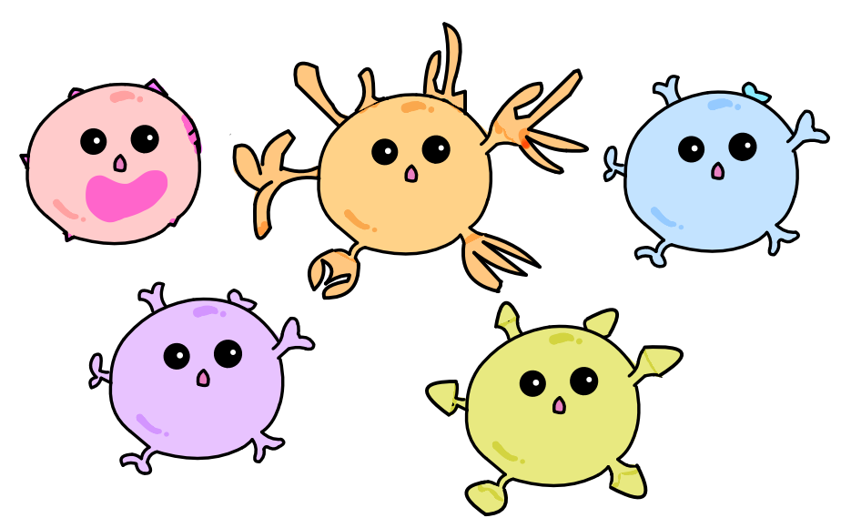







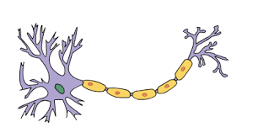
T cell subsets in t1d
Insulin-producing BETA CELLS
Tconvs
= T conventional Cells
Cytotoxic T cells
Helper T cells
Immune cells
Tregs= Regulatory T Cells
Dysfunctional Treg→ T1D
Kenneth Lai

Slide 6
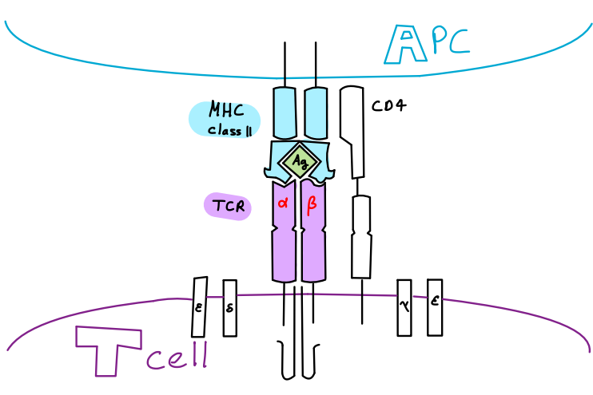
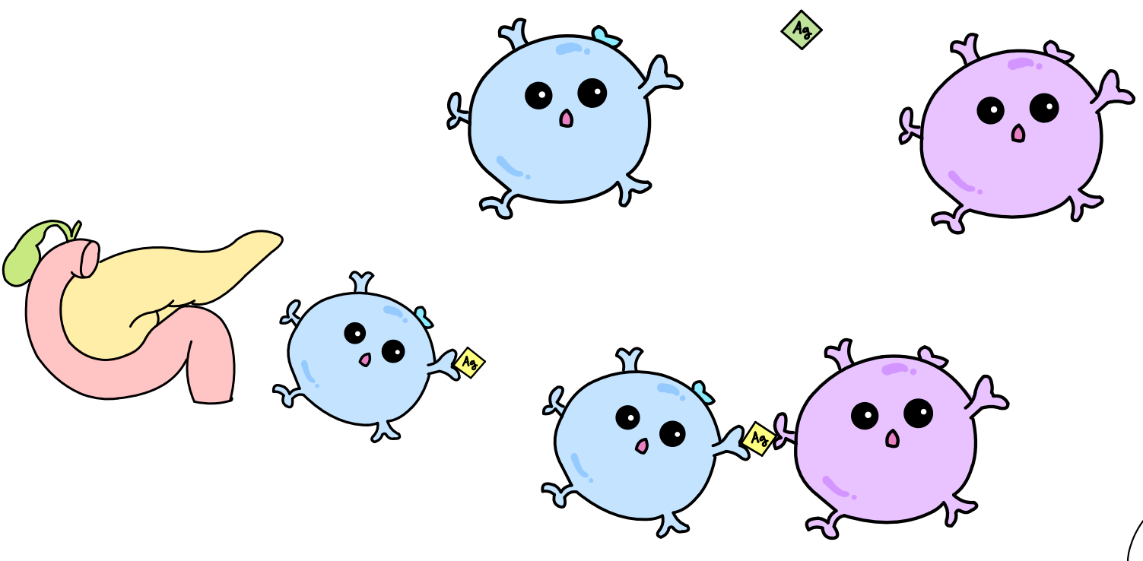
T cell receptors (tcrs)
Kenneth Lai

Slide 7
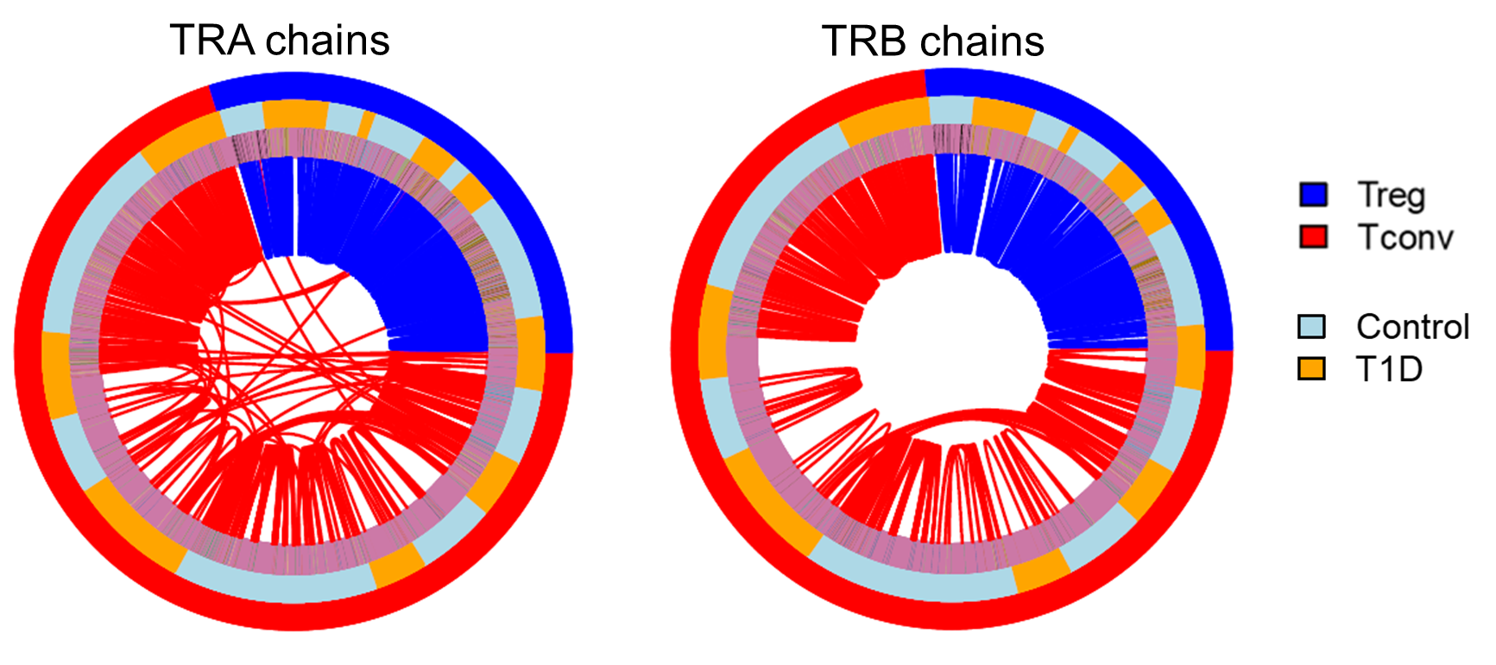
Islet tregs are expanded, share few tcrs with tconv cells
Sharing was defined as identical nucleotide sequence of TRA and TRB chains.
Alex Hu

Slide 8
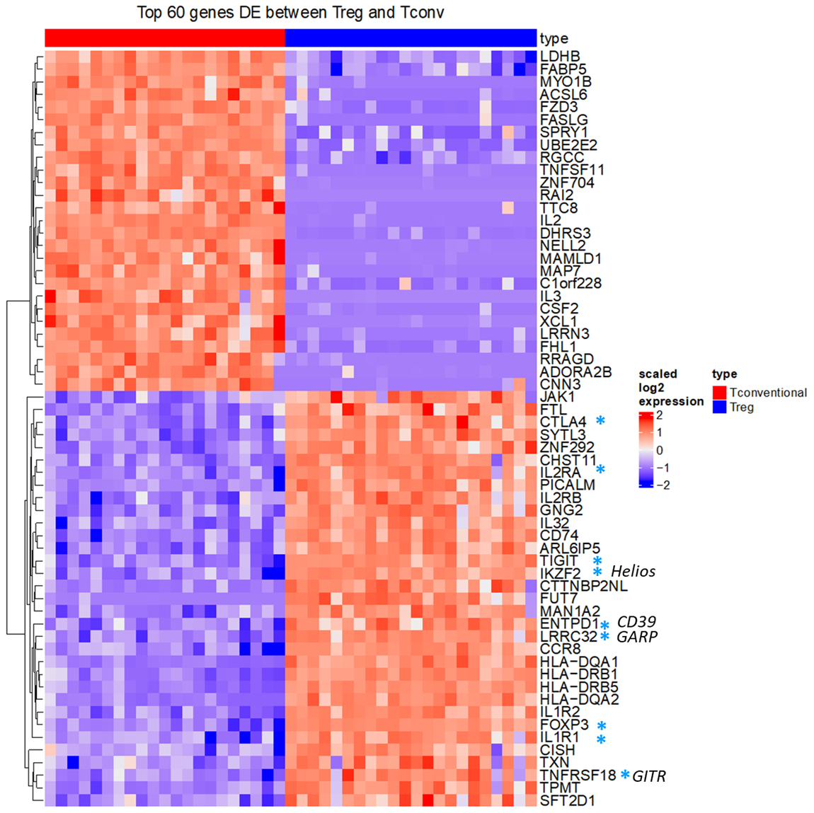
Islet Tregs are transcriptionally distinct from Tconv cells
Alex Hu
Notes:
1102 Treg / 2568 Tconv

Slide 9
Overview
Background & Motivation
Current Study
Goal
Design
Data & Results

Slide 10
Tcrs and t cell subsets in t1d
We aim to compare the TCR relationships between IAR Tregs:Tconvs and foreign-AR Tregs:Tconvs
Microbial (foreign)
IAR
Tconv
Tconv
TCR Clones
?
Treg
Treg

Slide 11
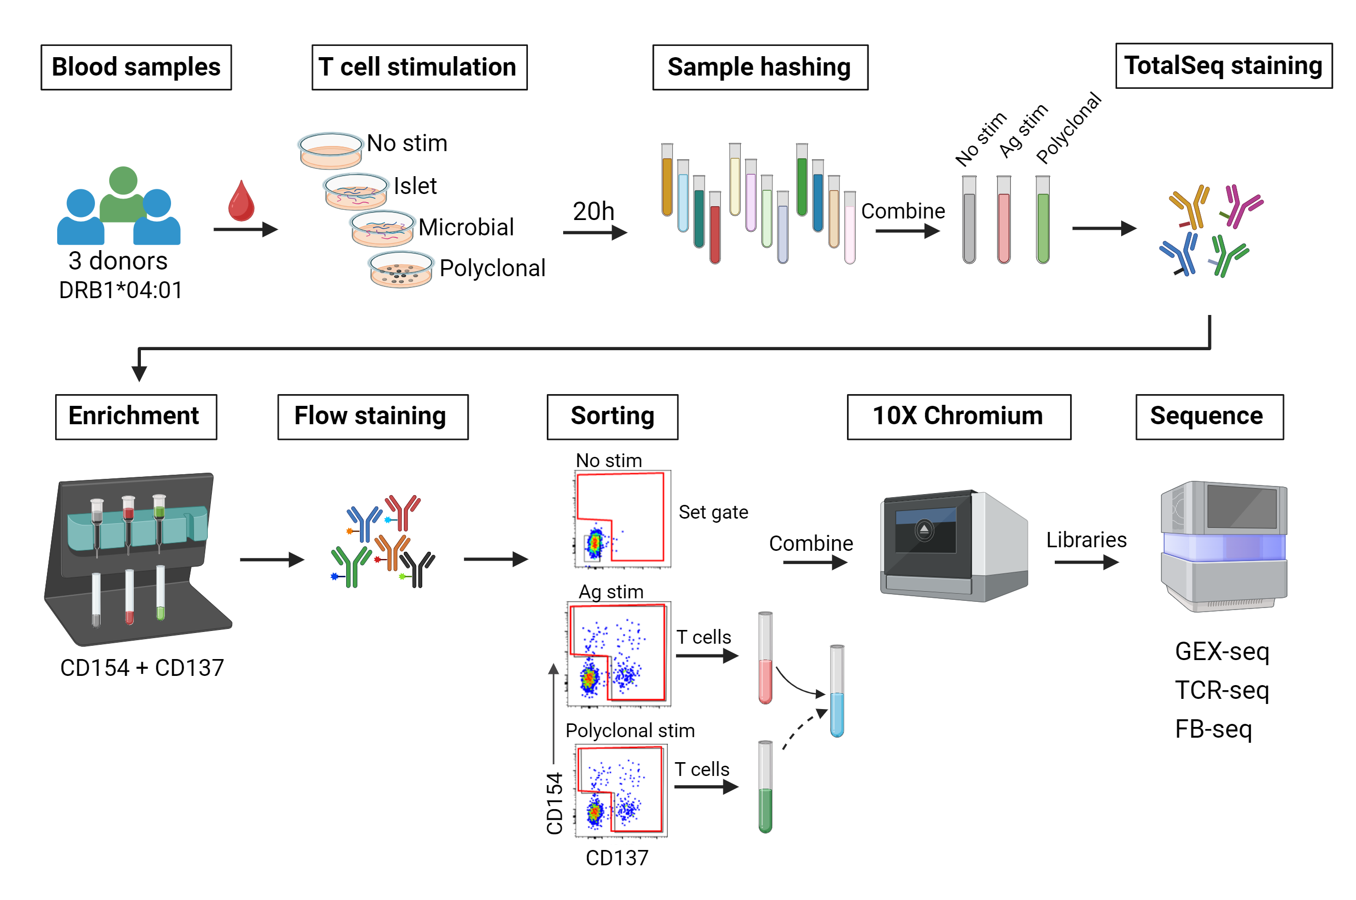
Experimental workflow
6
Created with BioRender.com
Notes:
GEM-X for libraries (5' GEX/TCR/ FB)
Illumina (NextSeq2000, P4 XLEAP) for sequencing
In-house alignment pipeline]

Slide 12
Overview
Background & Motivation
Current Study
Data & Results
Data QC + Metrics
TCR Recovery
GEX Visualization
TotalSeq/FB

Slide 13
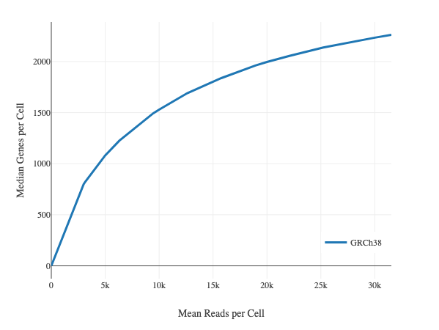
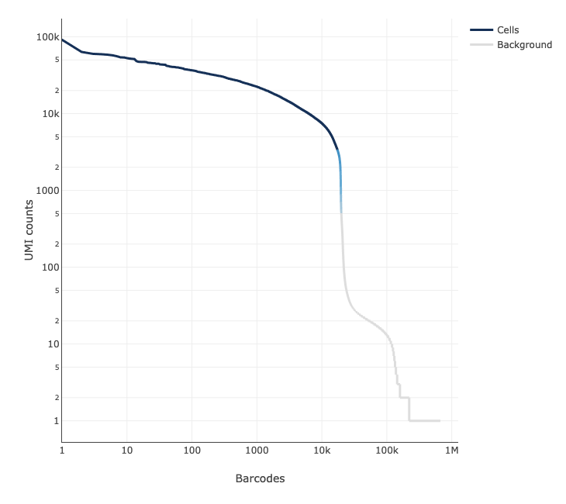
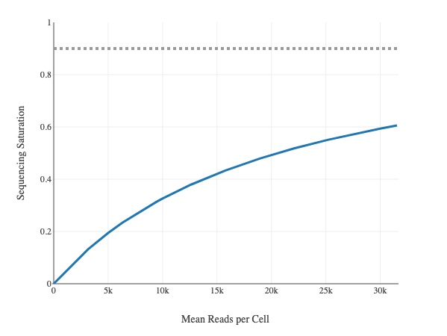
Qc overview - rnaseq
37420K cells recovered/ 106K loaded
Cell viability: 91%
2310 median genes/cell
24,244 total genes detected
8117 Median UMI counts/cell
Preliminary & unpublished: do not cite or distribute.

Slide 14
Qc - rnaseq
nFeatures/Cell are high
Preliminary & unpublished: do not cite or distribute.

Slide 15
Qc - rnaseq
Samples with higher mitochondrial read counts are lower in genes
Preliminary & unpublished: do not cite or distribute.

Slide 16
Hashtag demultiplexing
1873 Multiplet GEMs and 108 Negative GEMs identified and removed.
Preliminary & unpublished: do not cite or distribute.

Slide 17
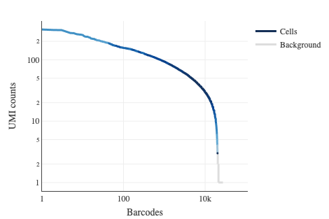
Productive v(d)j-spanning pairs found in 80% of cells
None ~ 5%
Alpha only ~ 9%
Beta only ~ 6%
Both ~ 80%
Removed: 35 iNKT, 11 MAIT cells, 1065 multiplets
Preliminary & unpublished: do not cite or distribute.

Slide 18
Cells passing qc for each hashtag
Microbial cells downsampled to 600 per donor
 | IAR | Microbial | Polyclonal
1_Control | 112 | 1422 | 42
2_T1D | 153 | 1869 | 160
3_Control | 238 | 3085 | 493
4_Control | 386 | 1327 | 602
5_T1D | 240 | 8342 | 275
6_T1D | 244 | 12384 | 436
Preliminary & unpublished: do not cite or distribute.

Slide 19
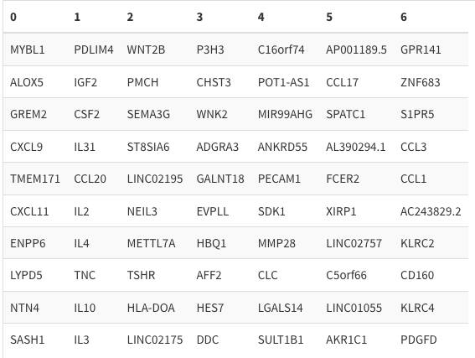
Distinct transcript profiles revealed by scrnaseq
PCA clustering optimized with Davies-Bouldin, Calinski-Harabasz, and Silhouette metrics UMAP embedding optimized with scDEED
Cluster-defining genes:
Preliminary & unpublished: do not cite or distribute.

Slide 20
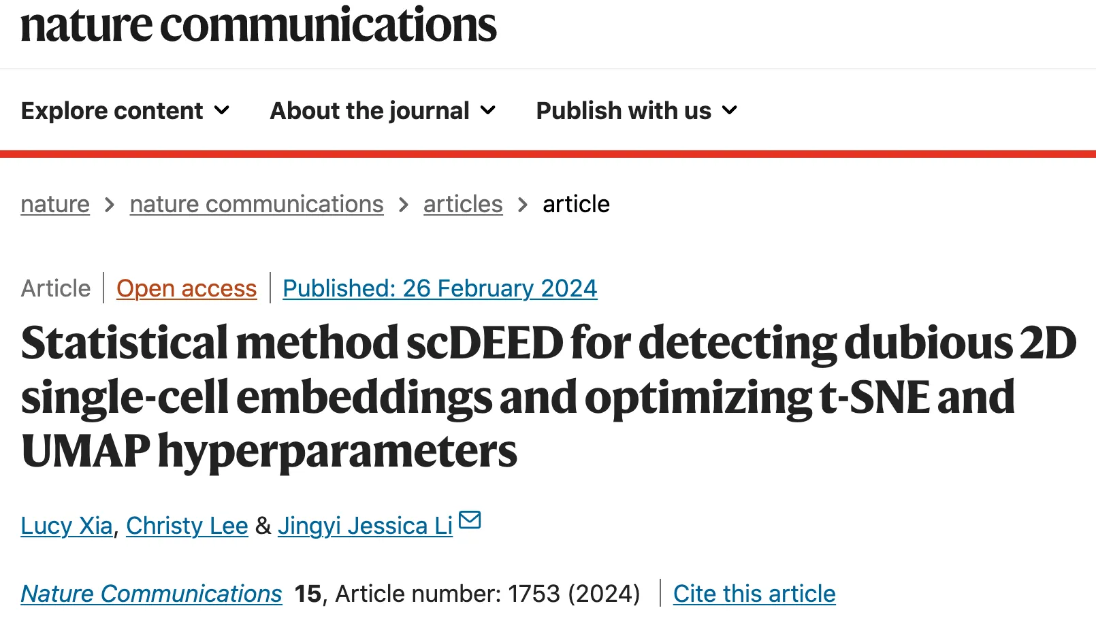
Umap hyperparameters optimized with scdeed
“The improvements achieved with this method are not stunning, but may be useful when a UMAP looks noisy, or when cell distributions on a map are critical to your findings.” –Hamid Belouri

Slide 21
Umap embedding trustworthiness/dubiosity
Preliminary & unpublished: do not cite or distribute.

Slide 22
Mean treg & mean Tconv signatures
Preliminary & unpublished: do not cite or distribute.

Slide 23
Mean treg & mean Tconv signatures
Preliminary & unpublished: do not cite or distribute.

Slide 24
P390 Treg/tconv genes
Preliminary & unpublished: do not cite or distribute.

Slide 25
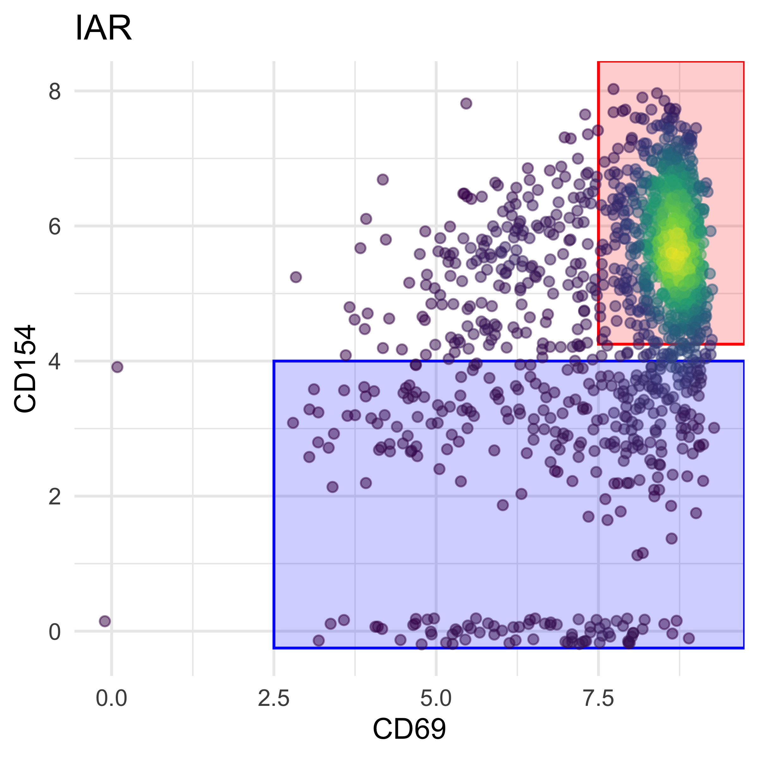
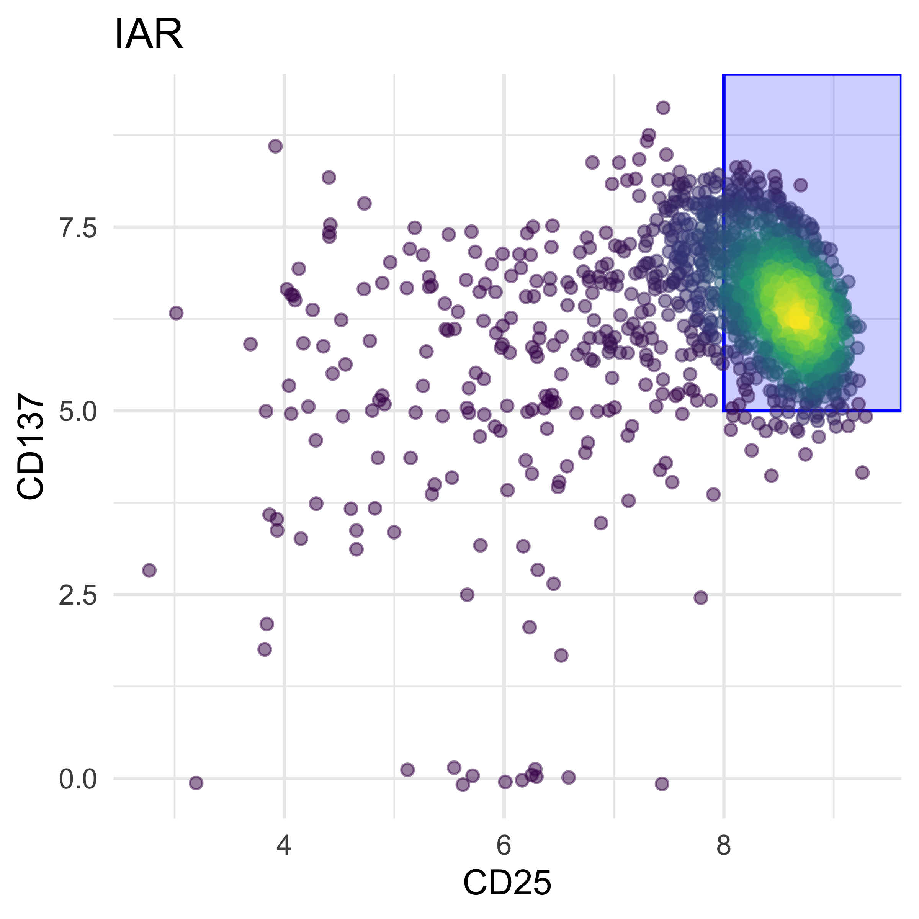
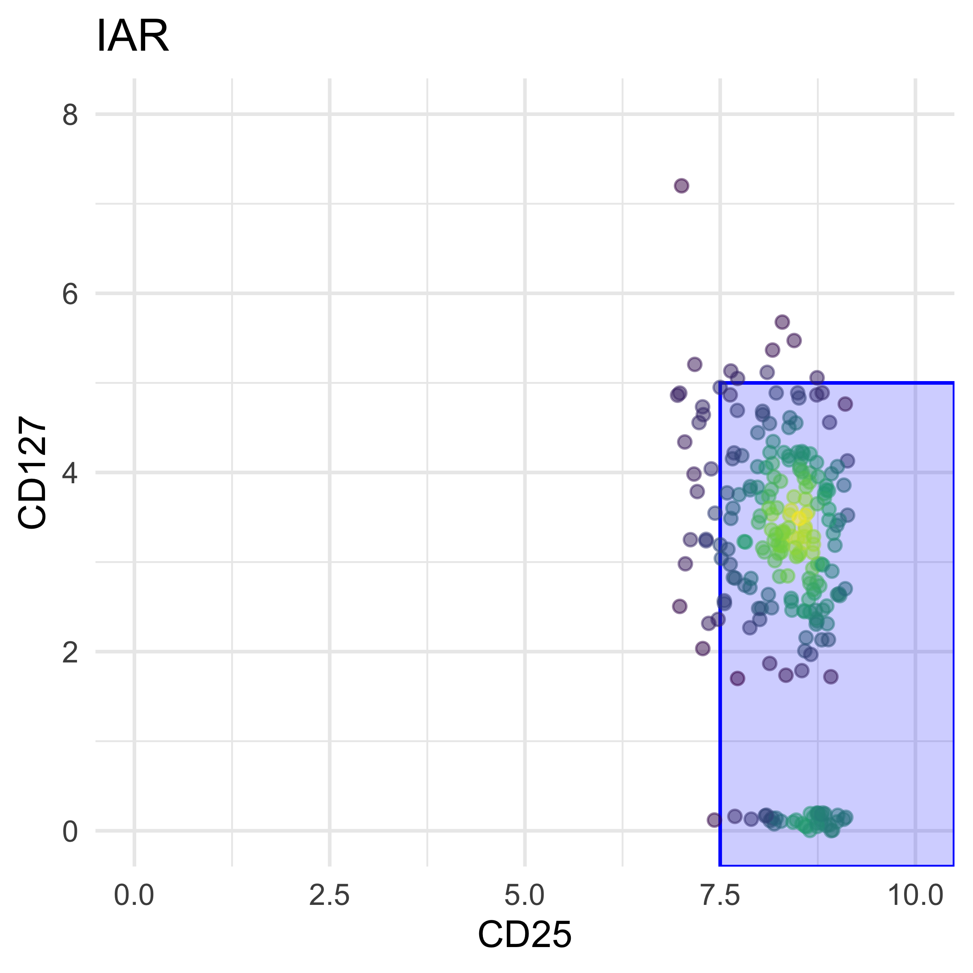
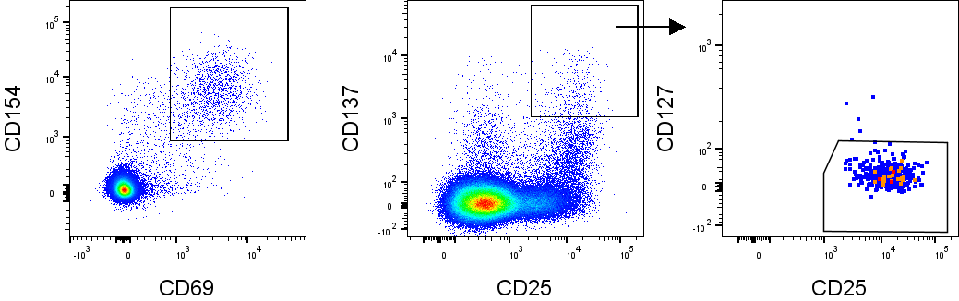
Treg and tconv cell calling by totalseq
Preliminary & unpublished: do not cite or distribute.

Slide 26
Umap with putative treg/tconv cell assignments
Preliminary & unpublished: do not cite or distribute.

Slide 27
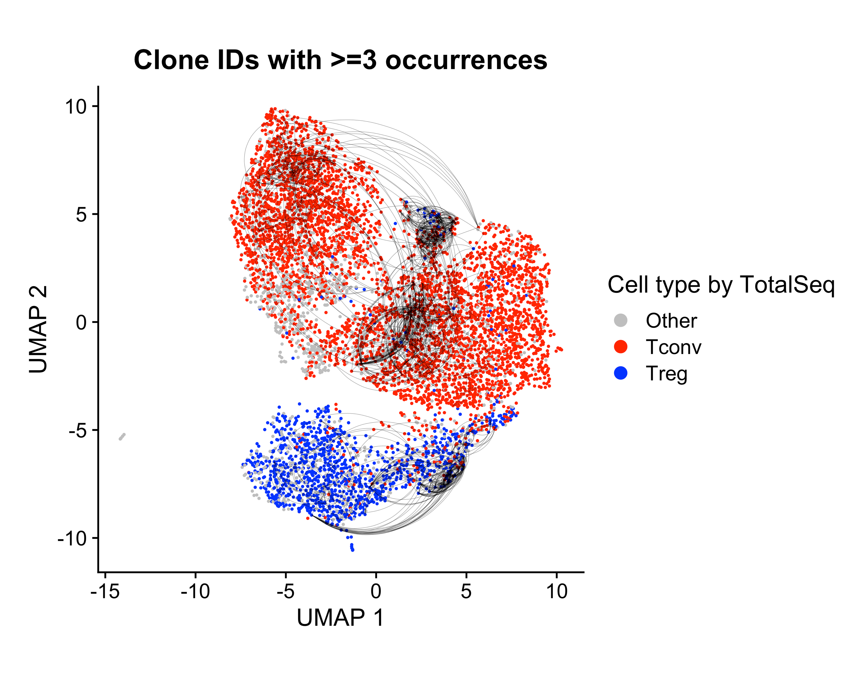
Investigation of tcr repertoires in iar/microbial t cells possible
Prior work: plate-sorted SMARTseq
Present study: GEM-X (5’ GEX, TCR, FB) with P4 XLEAP
Preliminary & unpublished: do not cite or distribute.
Alex Hu

Slide 28
conclusions
10X GEM-X supports complex multi-modal sc-sequencing experimental schemes to investigate subtle differences in immune cells.
High-quality RNA, TCR, and FB recovery enable a deeper look into the roles of Tregs and Tconvs in T1D.
The dataset supports the conclusion made previously that IAR Tregs and Tconvs have a limited degree of TCR sharing.
The dataset will support the central study question: do Tregs and Tconvs implicated in T1D behave similarly to their microbial-targeting relatives?

Slide 29
Acknowledgements
Bioinformatics Core
Hannah DeBerg
Stephan Pribitzer
Matt Dufort
Alex Hu
Matt Lawrence
Ty Bottorff
Andrew Koval
Kenneth Lai (2023 intern)
Genomics Core
Vivian Gersuk
Kimberly O’ Brien
CATA Core
Adam Wojno
Cerosaletti Lab
Karen Cerosaletti
Janice Chen
Software & Data Management
Charlie Quinn
Alex Walker
Adarsh Manjunath
Anna Bjork
Robyn Meshulam
Seattle Children’s Research Center
David J. Rawlings

Slide 32
Notes:
EVALUATED ON THE 2D UMAP EMBEDDING
THESE PUSH FOR READABILITY OF THE UMAP, WHICH MAY NOT BE FOR THE BEST.

Slide 33
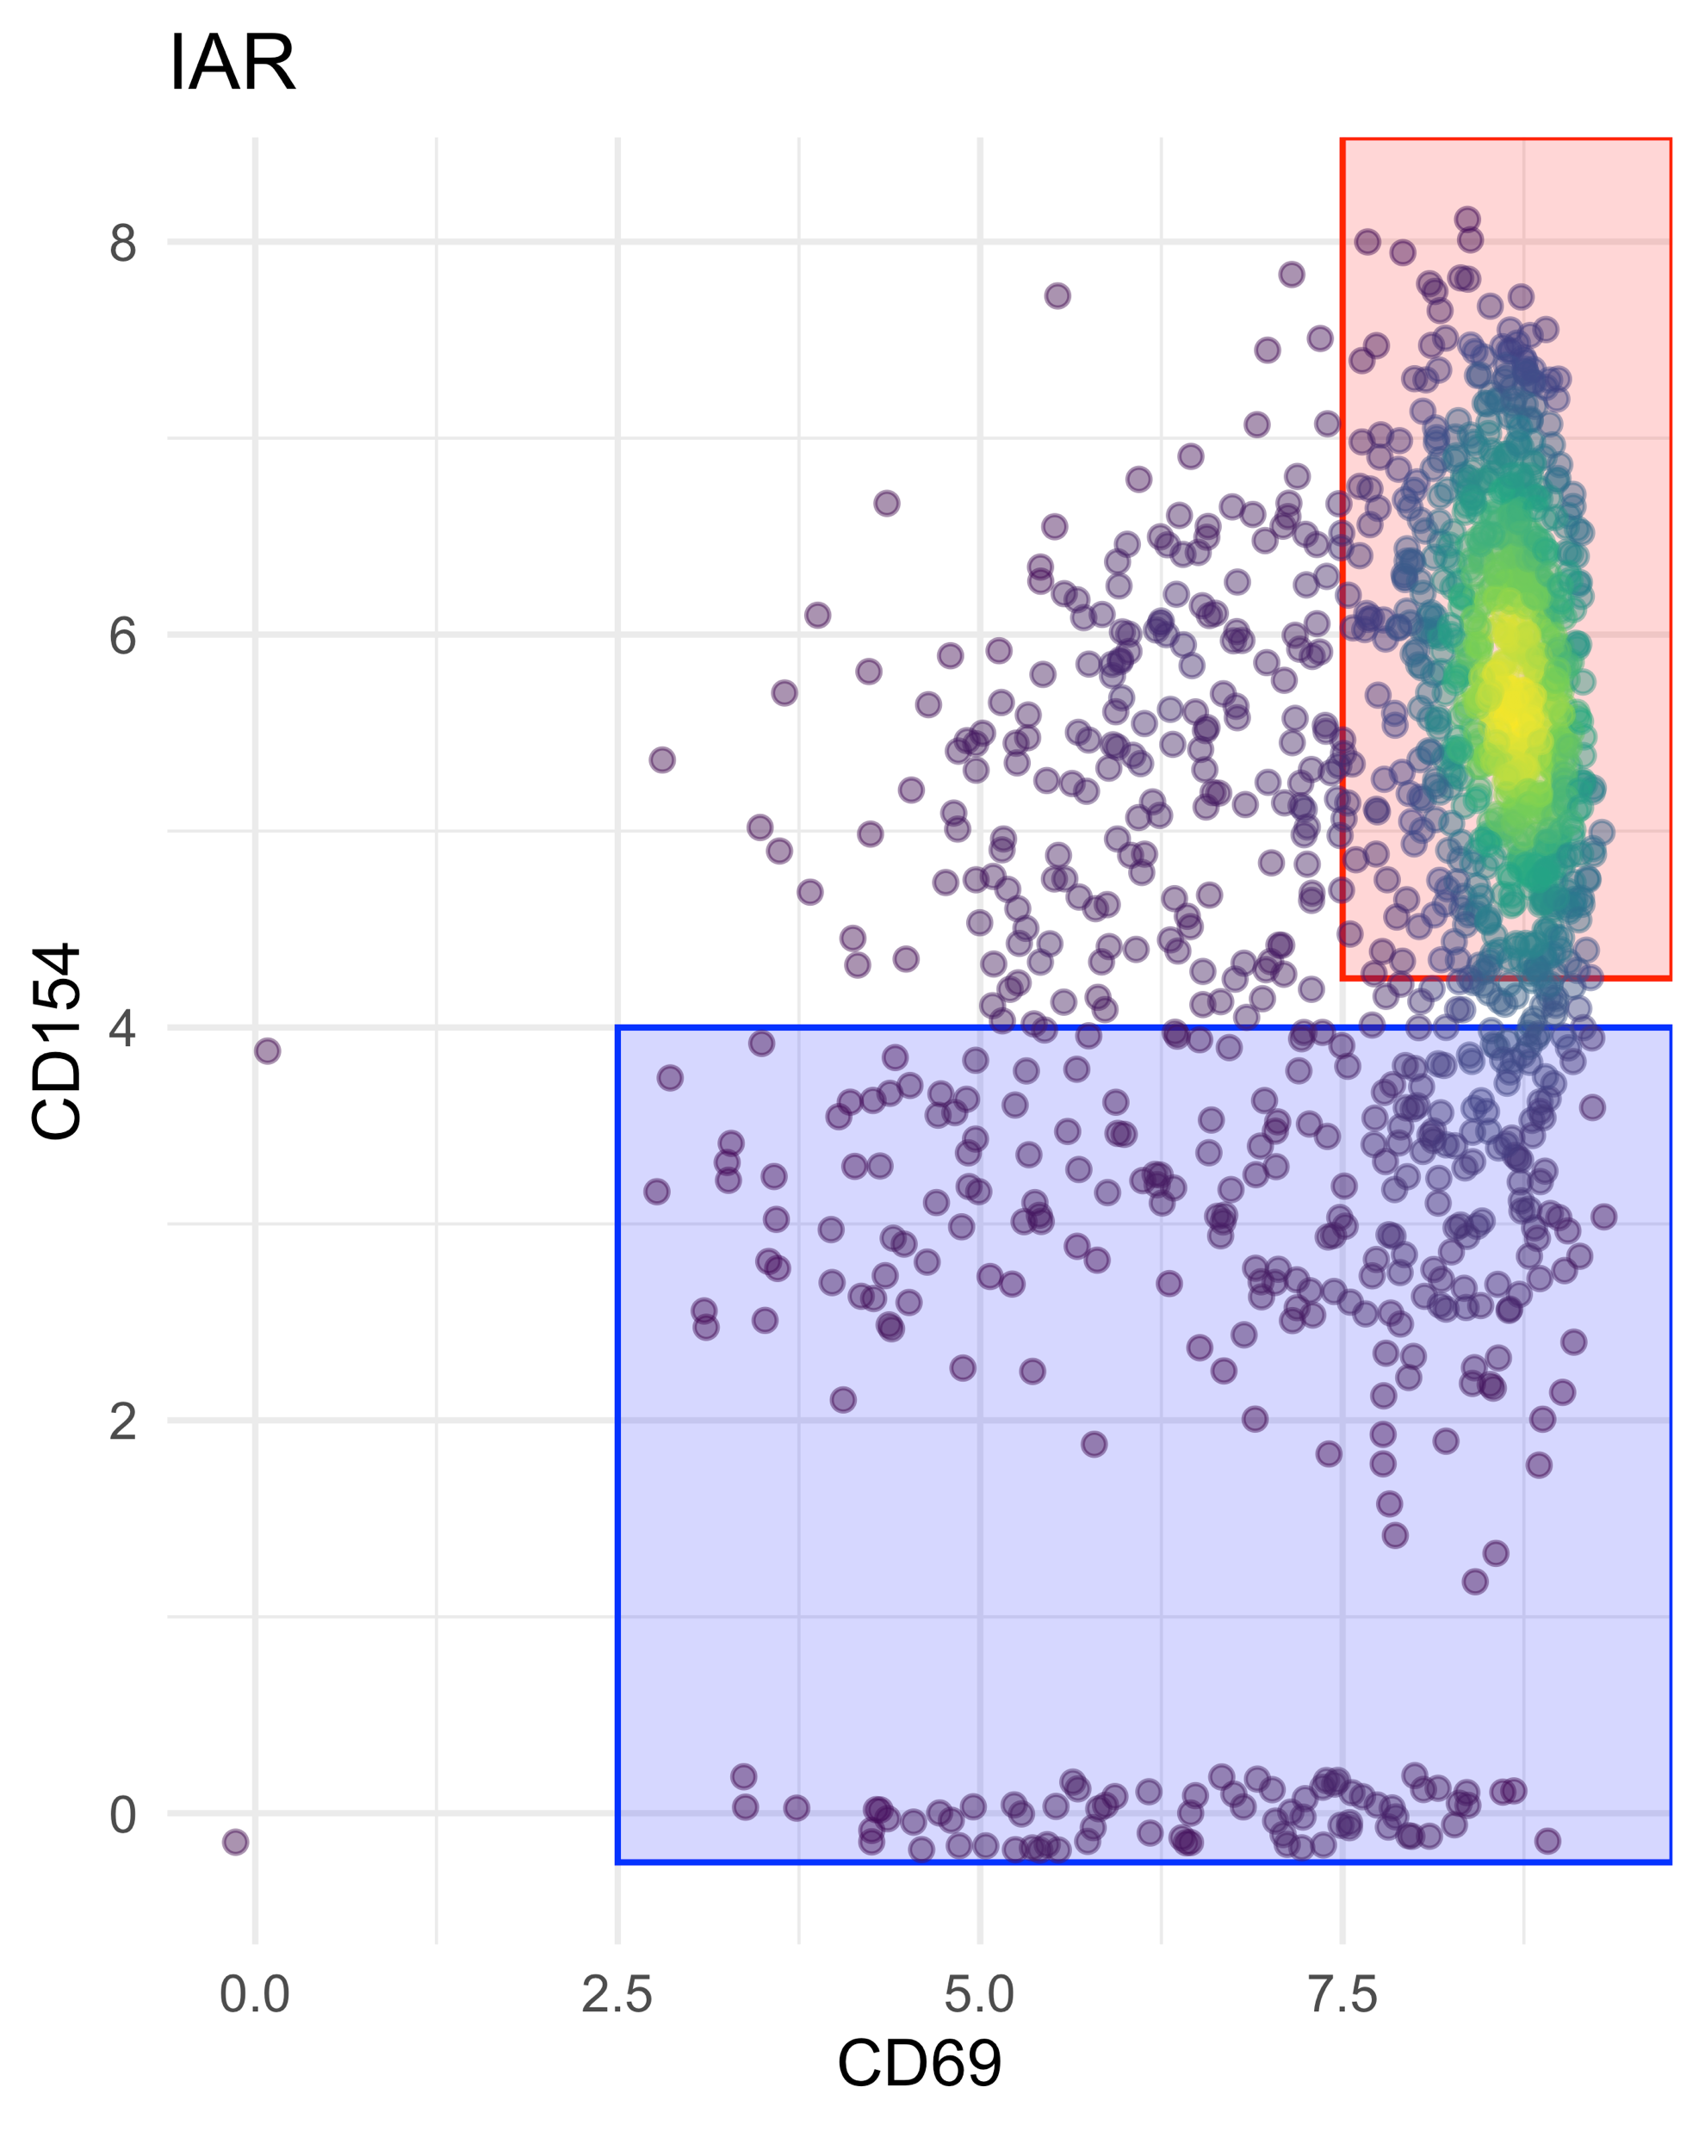
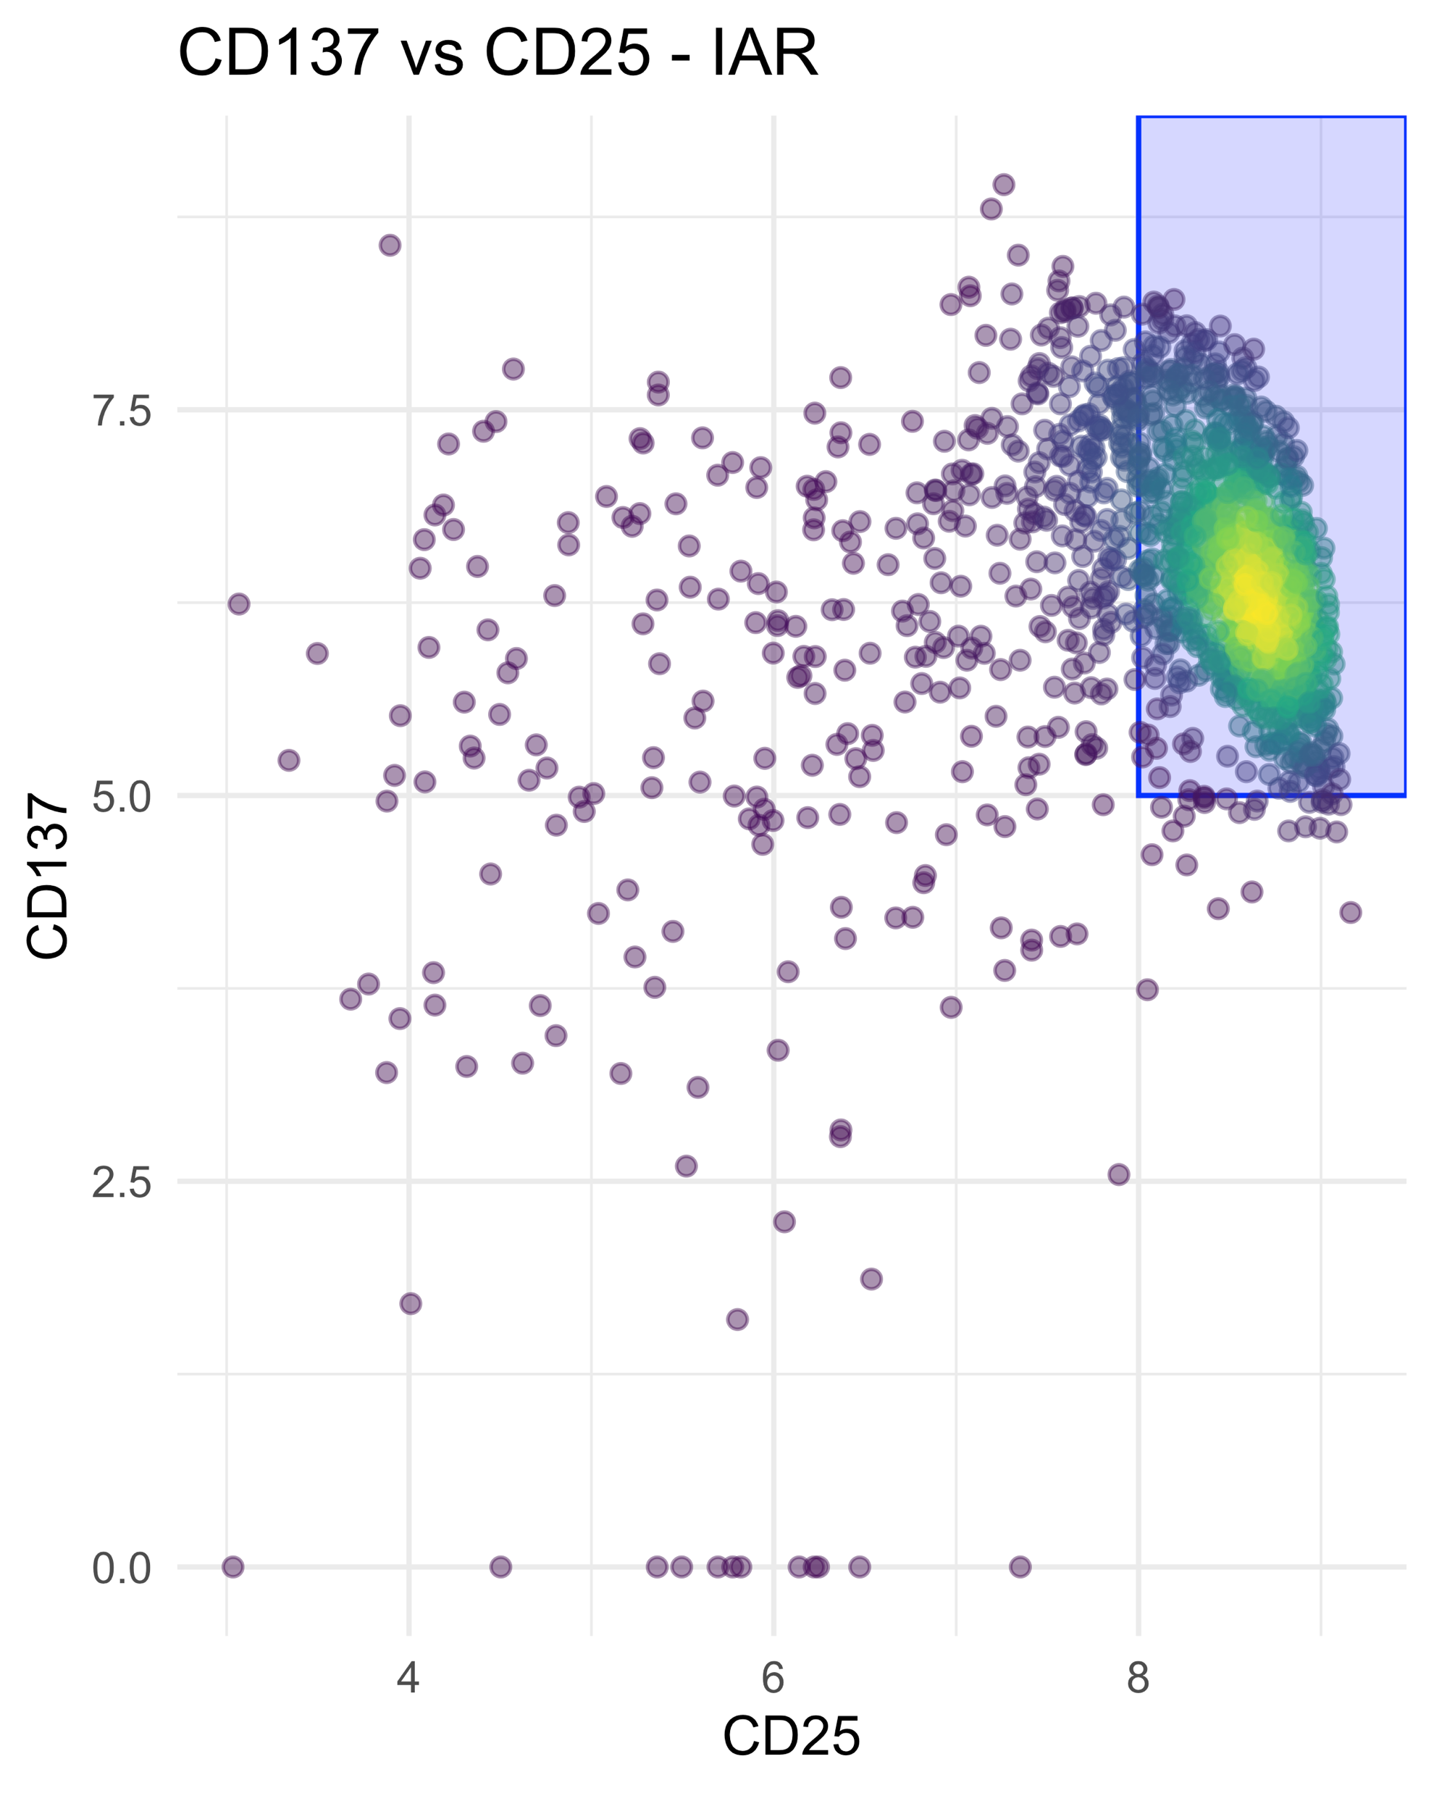
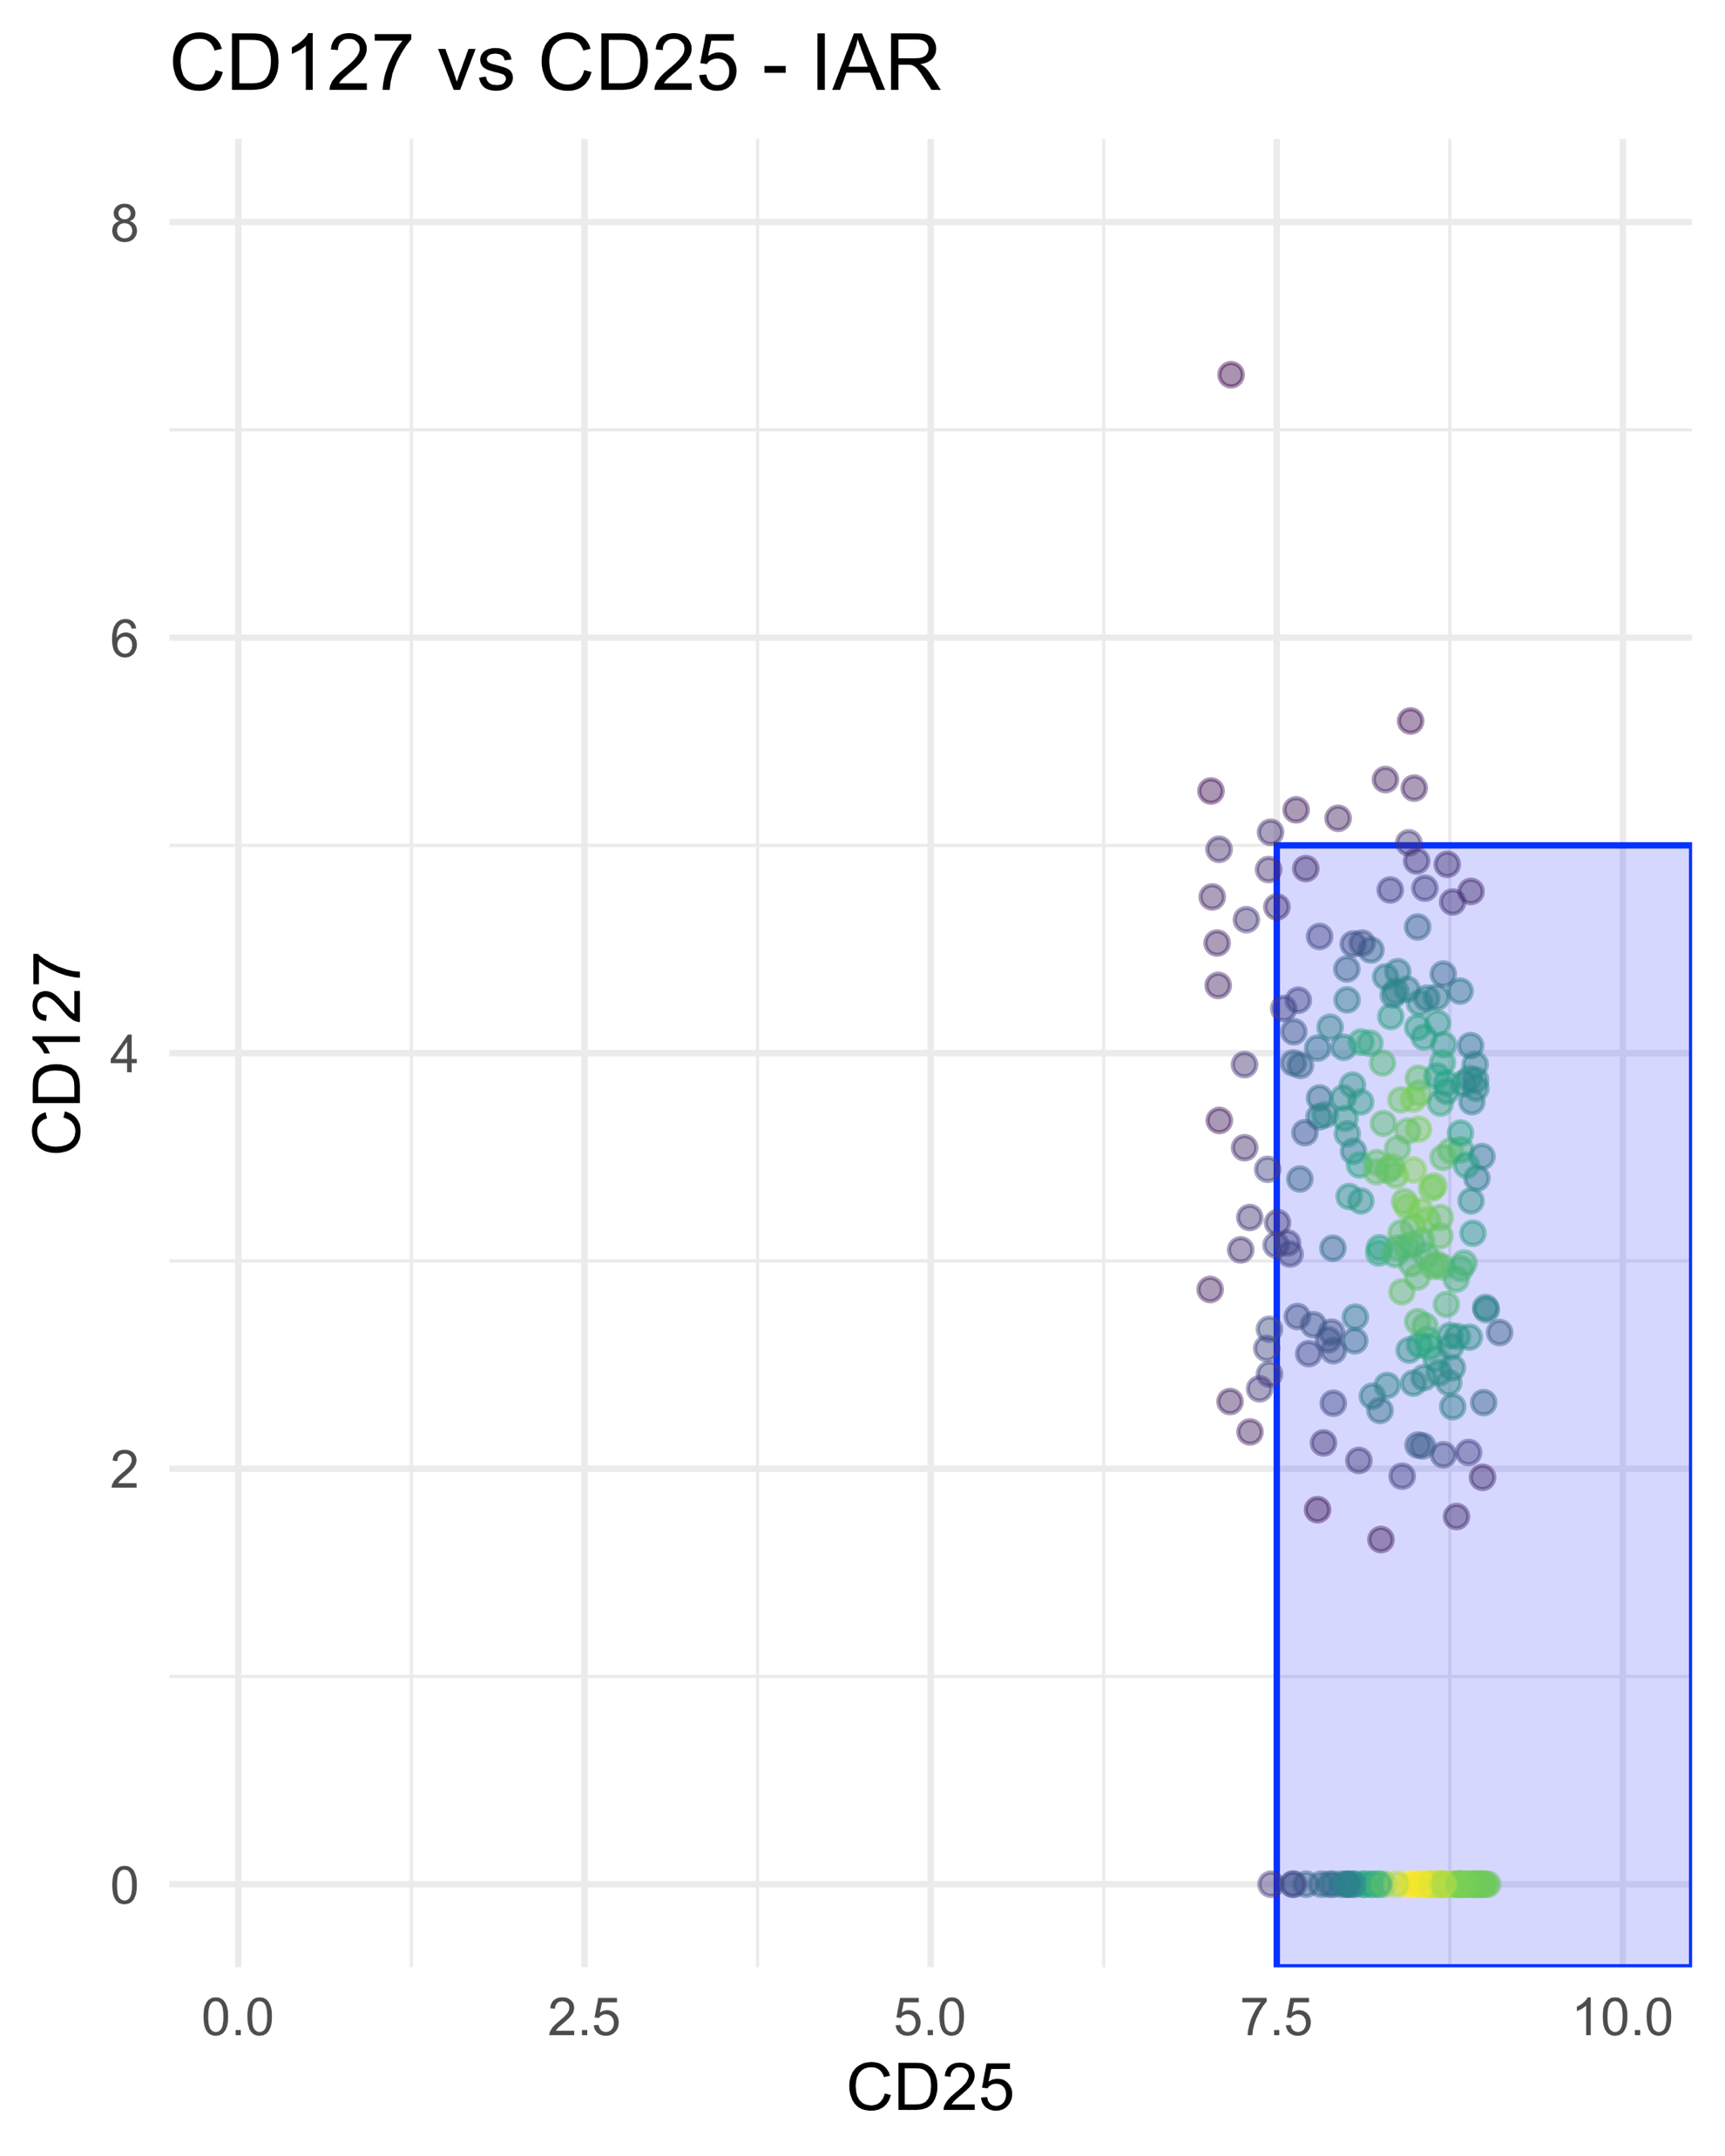
Treg and tconv cell calling by totalseq
Tconv
Preliminary & unpublished: do not cite or distribute.

